Slide 1
My Understanding of EEG/biometrics so far
By: Steven Cao (08/17/2021)

Slide 2
Paper - EEG Biometrics for Individual Recognition in Resting State with Closed Eyes
GOAL
In this paper EEG signals are employed for the purpose of automatic user recognition. Specifically the resting state with closed eyes acquisition protocol has been here used and deeply investigated by varying the employed electrodes configuration both in number and location for optimizing the recognition performance still guaranteeing sufficient user convenience.
Classifier
The method: Used an autoregressive (AR) model and polynomial regression based classification for identifying the most distinctive contributions of the different sub-bands in the recognition process
In what terms are you optimizing the electrodes configuration for?
By the classification percentages for user recognition

Slide 3
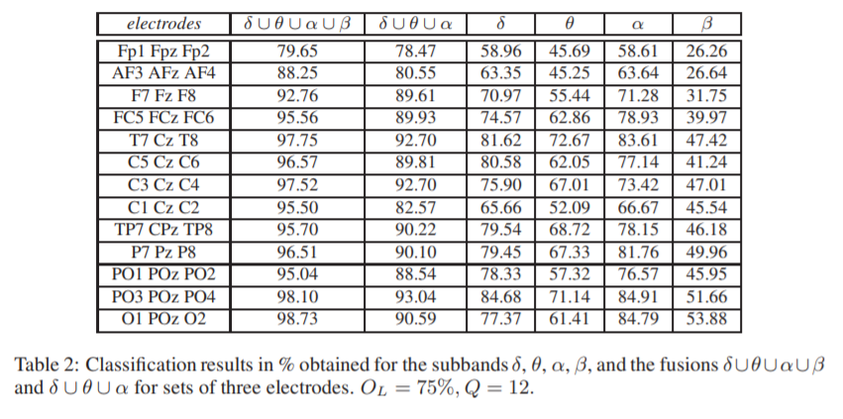
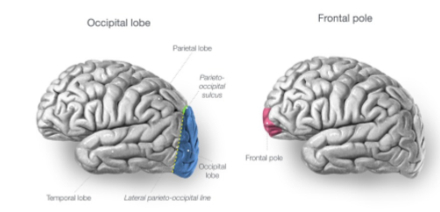
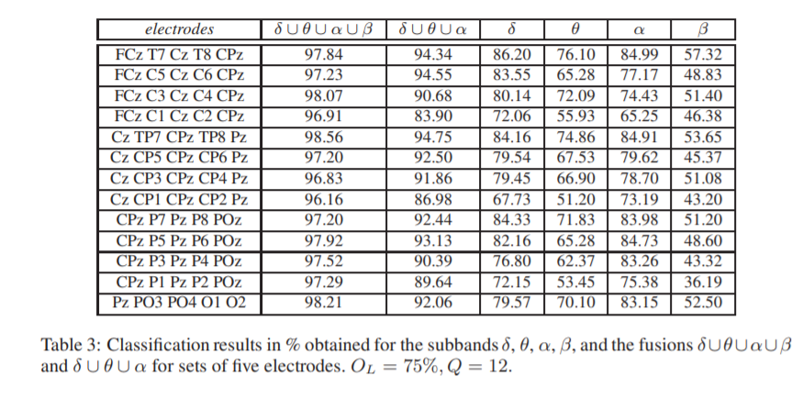
Spatial Configurations to use for best recognition
Definition: spatial configuration describes the spatial pattern of patches in a landscape
The channel spatial configurations giving the best performance have been proven to be located mainly in the parieto-occipital area PO of the scalp (O1-POz-O2, PO3-POz-PO4, Cz-TP7-CPz-TP8-Pz, Cz-P7-CPz-TP8-Pz), while the worst performing sets of electrodes are placed in the fronto-polar region FP (FP1-FP2, FP1-FPz-FP2).

Slide 4
Why the method/conclusion/task?
Why use the AR model for EEG classification of users?
A study showed that it is possible to fit AR models to EEG data and then use the AR coefficients as features for clustering or classifying data (understand AR)
Why the parietal-occipital area had the best results for user recognition using the REC?
The parietal lobe processes information about temperature, taste, touch and movement, while the occipital lobe is primarily responsible for vision.
Why the task of using EEG signal for user recognition?
Such a kind of studies has led in recent decades to the use of the brain signal in EEG-based-communication systems, like brain machine interface (BMI) and brain computer interface (BCI), aiming at controlling remote devices by means of brain electrical activity
The interest in using EEG biometrics for automatic person recognition is due to some advantageous peculiarities with respect to other commonly used biometrics, such as privacy, robustness to spoofing (imitating another one’s identity) attacks and universality (anyone can use it: speech-impaired, disabled people who doesn’t have hands)
Facial images and fingerprints can often be obtained without the consent of subjects, but this is not the case for brainwaves. Tracing an individual based on facial images, signatures, or voices is elementary, but EEG data is difficult to obtain. Even if an EEG data storage system were compromised, it would be difficult to find the true identity of a person based on the features of his EEG data. This greatly enhances the security of enrolled clients.

Slide 5
Paper - Electroencephalogram subject identification: A review
GOAL
This work is a comprehensive research on the state of the art on EEG based biometric systems from its origins until the end of 2013. In particular, it aimed to answer the following questions:
What are the subject specific traits of the EEG?
Traits: peak frequency, power frequency, beta band
Where are these traits in terms of space and frequency?
Are they constant across recording paradigms (sub-task) and time?
Understand what is a paradigm?
One of the purposes of this paper was to prove that resting-state can be used as a paradigm for creating a biometric system in a larger dataset than in our previous work.

Slide 6
Conclusions
Which are the subject specific traits of the EEG?
Genetic and physiology studies affirm that the power and peak frequency of the alpha band present the strongest heritability relationship, followed by the beta band. Nevertheless, they proved to be insufficient to obtain high accuracy rates on biometric systems, forcing researchers to explore the usage of different characteristics.
Where are these traits in terms of space and frequency?
Info on channel positions
Results reporting occipital, temporal and parietal areas as the ones providing the most discriminant information under REC condition could be expected
Their results suggest that parietal areas near the temporal lobes carry the most discriminant information.
Differences in frequency bands
On the REC paradigm, neurophysiology as well as biometric studies concluded that alpha and delta rhythms are the most discriminant, followed by the theta and the beta
Are they constant across recording paradigms and time?
Studies on diet and circadian effects revealed how sensitive a EEG-based biometric system could be to changes of the EEG elicited by common events, such as the intake of coffee or daily physiological changes.
Genetic and neurophysiology studies have described changes on the human EEG across maturation, some of which are related to the heritable traits
Everytime, you read an article, especially, if it’s a review article, ask yourself what path do you think we should take and then do an analysis for it

Slide 7
Why the conclusions?
Results reporting occipital, temporal and parietal areas as the ones providing the most discriminant information under REC condition.
The occipital lobe is the back part of the brain that is involved with vision.
This aligns with the acquisition protocol, REC condition, since we close your eyes.
The parietal lobe processes information about temperature, taste, touch and movement
The parietal lobes determine the visual coordinates and plan the visually guided movement of the limbs to pick it up
This aligns with the acquisition protocol, REC condition, since by closing your eyes, you essentially make it not able to focus on any object, thus definitely causing significant changes in the brainwaves in that region.
The temporal lobe processes memories, integrating them with sensations of taste, sound, sight and touch.
This aligns with the acquisition protocol, REC condition, since by closing your eyes, the sensations of sight is dampened, thus definitely causing changes to the brainwaves.
Biometric studies concluded that alpha and delta rhythms are the most discriminant, followed by the theta and the beta
Alpha waves are seen in the electroencephalogram (EEG) during a normal wakeful state where the subject is quietly resting.
Beta waves are present when a person is alert/attentive and thinking actively.
Theta waves (Stage 1) of sleep is present during the transition from wakefulness to sleep.
Delta waves are associated with deep sleep stages.
How sensitive a EEG-based biometric system could be to changes of the EEG elicited by common events, such as the intake of coffee or daily physiological changes.
The effects of caffeine may often be overlooked in neurotherapy. It also has a rapid and profound influence on the brain, including producing increases in beta and decreases in slower brain wave activity (delta)

Slide 8
Paper - Challenges and Future Perspectives on Electroencephalogram-Based Biometrics in Person Recognition
GOAL
This article reviews the various systems proposed over the past few years with a focus on the shortcomings that have prevented wide-scale implementation, including issues pertaining to temporal stability, psychological and physiological changes, protocol design, equipment and performance evaluation.

Slide 9
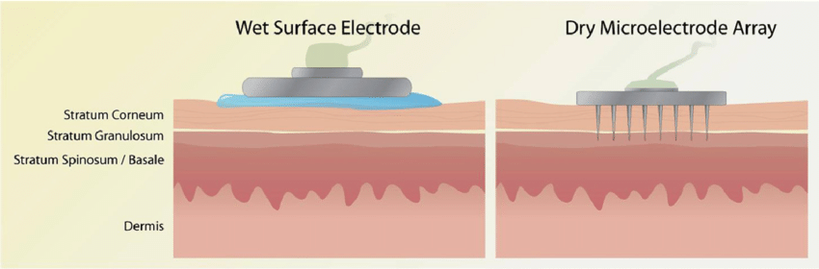
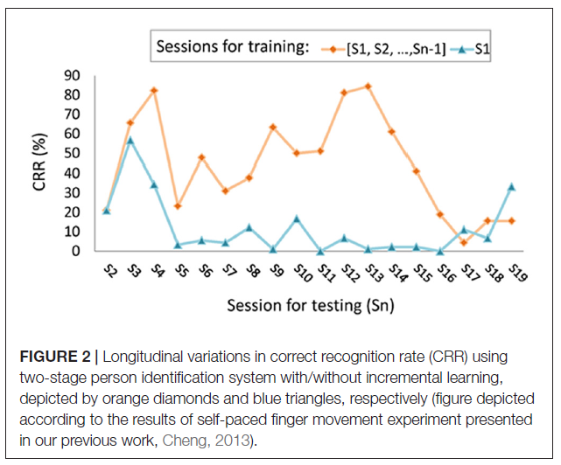
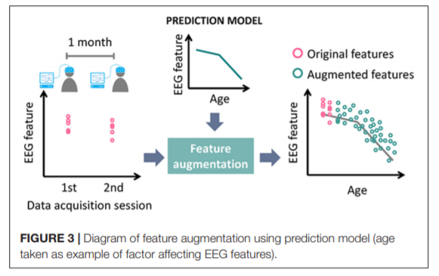
Challenges facing in building an EEG/biometric system
Operations
How is the system operation going to be easy to operate such that all users can operate it without an operator.
What does it mean by easy operation? (Ex. When putting on the embedded-electrode cap, if you shift it, it won’t compromise the system)
The idea is that you don’t need an operator to tell you anything.
Path: Ear-EEG is another comfortable approach by which the EEG can be acquired from the electrodes placed on an earpiece
A user-friendly EEG biometric system can really only be achieved using a small number of dry electrodes. The system protocols be: accessible; time-efficient; reproducible; and practice-free
Stability of System Performance
How is the system going to recognize clients after many days, months, or years?
Is this problem a EEG signal analysis problem using ml?
Path: EEG data obtained under various conditions and at different times should be included in the training data sets.
Incremental Learning to an EEG-based person identification system: multiple sessions (Figure 2)
Robustness to the Psychological and Physiological Changes
How is the system going to keep being able to accept you after you aged or are under stress/anxiety/pain?
Is this a good thing, since people can then be forced to put their brainwaves and they will allow it?
No previous study has addressed the stability and robustness of EEG-based biometric features under relevant-to-life conditions. (2018)
Path: Requires an understanding of the factors affecting EEG, as well as a means of selecting EEG features with high stability and distinctiveness.
Brain connectivity can also help with modeling these changes. Complexity of data embedded in EEG can be used to differentiate among entities.(entropy)
Signals evoked by eye-movement can be a potential feature of EEG signals.
Ex. Take aging as an example, where the power of auditory event-related low frequency oscillations decreases over time. The accumulation of abundant knowledge concerning the influence of various factors makes it possible for researchers to build a model capable of making accurate predictions of EEG features under varying conditions. (Figure 3)
Equipment
What are the devices that we are going to use for EEG-based biometric systems when moving to the real-world? (dry electrodes)
Wet electrodes that use a layer of conductive gel or paste to increase conductivity between the electrodes and the test subject's skin.
Dry electrodes, however, do not require conductive gel and are set up much faster.
The wireless transfer of data (using Bluetooth perhaps) from the electrodes to the IPhone.
Path: Multimodal Biometrics: using both face recognition, fingerprinting, and EEG signals at the same time.
Path: Multitasking Biometrics by integrating EEG features from multiple tasks –resting, visual counting into the classifier

Slide 10
Challenges continued.
User Database
How is the system going to be able to correctly classify multiple users? (variations among users)
User databases are the database where we will create for storing the data and the user starts to work with the data.
Path: Two-Stage System to Minimize FAR While Keeping TAR
Two-stage person authentication system: (1) potential impostors are identified in the first stage to reduce FAR; then (2) measures are taken to verify their status as impostors in order to reduce FRR.
Protocol Design
What is the system going to use to check if a person is legit
Ex. Several protocols have been used for EEG systems, such as non-task (resting state, hands movement), tasks with sensory inputs (e.g., visual/auditory stimuli) and cognitive tasks. Cognitive tasks include those involving counting, problem-solving, mental rotations, letter composing/reading/spelling, memory retrieval and object recognition.
Which is better, using non-task, tasks with sensory inputs or cognitive tasks?
Path: its pretty straightforward: test, test, and test
Performance Evaluation
How are they going to evaluate your EEG signal (accuracy, roc curve, false acceptance rate, true acceptance rate)
Uniqueness of EEG Traits among Twins and Relatives
How are they going to differentiate being twins since some EEG traits are heritable such as alpha frequency

Slide 11
